Slide 1



NUMERICAL INVESTIGATION ON NANOFLUID MIXED CONVECTION IN TRIANGULAR DUCTS HEATED BY A UNIFORM HEAT FLUX
PRESENTED BY:
Sai Praneeth 711956
Srikar 711928
Sai Ganesh 711919
Yuvaraj 711961
SUPERVISOR
Dr. Santhosh kumar
Associate Dean,
Dept. of Mechanical Engineering

Slide 2
Introduction
Heat Transfer rate is an important criteria for proper functioning of machinery in industrial and research applications.
In order to increase transfer heat these thermal devices implement circular or non circular ducts filled fluid for convective heat transfer.
The performance of the ducts can be increased in two different ways.
By changing shape or using a nano particle infused working fluid.

Slide 3
Introduction
In our project , we consider a triangular sectioned duct due to its compactness and ease of construction.
We use pure water H₂O as base fluid and 3 different nano particles Al₂O₃ , SiO₂ and TiO₂.
We evaluate and compare their thermal features and fluid dynamic with different Richardson number values and different nano particle concentrations.

Slide 4
Geometrical description
On a three-dimensional duct model with an equilateral triangular section, a numerical thermal and fluid-dynamic investigation was conducted.
According to Figure 1, the overall length L is 2.0 m, whereas the internal edge L is 0.017 m. The hydraulic diameter, dh = 4A/Ph, is therefore equal to 0.01 m.
The duct has a 1.5 m-long developing section at the entrance, followed by a 0.4 m-long test section and an outlet section.

Slide 5
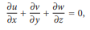
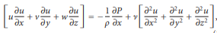
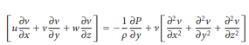
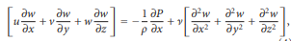
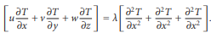
.

Slide 6
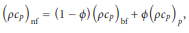
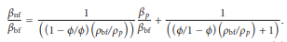
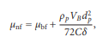
.

Slide 7
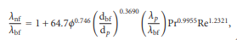
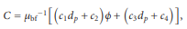
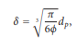
.

Slide 8
Grid Independent Analysis:
Mesh-Size | Number of Nodes | No of Elements | Nusselt number
2.5 mm | 31840 | 22260 | 4.144
2 mm | 60000 | 44955 | 4.053
1.5mm | 111300 | 87384 | 4.463
1mm | 341829 | 287712 | 3.616
0.75 mm | 757614 | 662000 | 3.503
0.65mm | 1024458 | 903279 | 3.505
0.5mm | 2296574 | 2088000 | 3.413
Table-1: Nusselt Numbers for different Mesh size taken at 0% volume concentration and Richardson number equal to 0.1
Graph-1: Nusselt number vs No of Elements

Slide 9
Heat Transfer Coefficient for different Richardson numbers and different volume concentration values:
RI | Heat transfer coefficient for 0% | Heat transfer coefficient for 1% | Heat transfer coefficient for 2% | Heat transfer coefficient for 4%
0.1 | 5.448133 | 6.313574 | 7.354223 | 10.66781
0.5 | 21.25401 | 24.13026 | 27.49459 | 37.61598
1 | 34.20216 | 38.32862 | 43.09314 | 57.02608
2 | 50.52384 | 55.85764 | 61.9484 | 79.28623
3 | 60.97899 | 66.90591 | 73.63438 | 92.51907
5 | 74.30826 | 80.81237 | 88.13717 | 108.3699
Table-2: Heat transfer coefficient values for volume concentrations 0%, 1%, 2%, 4% and for Richardson number varying from 0.1 to 5
Graph-2: Richardson number vs average heat transfer coefficient values for different volume concentrations.

Slide 10
Nusselt Numbers for different Richardson numbers and different volume concentration values:
RI | Nusselt numbers for 0% | Nusselt numbers for 1% | Nusselt numbers for 2% | Nusselt numbers for 4%
0.1 | 5.3543 | 5.255901 | 5.161876 | 5.010048
0.5 | 6.098 | 6.05632 | 6.030042 | 6.005631
1 | 6.4867 | 6.46124 | 6.445648 | 6.442568
2 | 6.85969 | 6.84681 | 6.843439 | 6.854026
3 | 7.059503 | 7.05185 | 7.052512 | 7.072361
5 | 7.28892 | 7.28625 | 7.291333 | 7.319479
Table-3: Nusselt Number values for volume concentrations 0%, 1%, 2%, 4% and for Richardson number varying from 0.1 to 5
Graph-3: Richardson Number vs Nusselt Number values for different volume concentrations.

Slide 11
Average Shear stresses for different Richardson numbers and different volume concentration values:
RI | Avg shear stress for 0% | Avg shear stress for 1% | Avg shear stress for 2% | Avg shear stress for 4%
0.1 | 0.006635436 | 0.00761144 | 0.008943619 | 0.01345261
0.5 | 0.006806649 | 0.007800849 | 0.009149997 | 0.01370168
1 | 0.007022164 | 0.008039304 | 0.009411325 | 0.01402205
2 | 0.007462541 | 0.008532352 | 0.009957971 | 0.01470695
3 | 0.00791004 | 0.009037794 | 0.01052422 | 0.01543468
5 | 0.008801587 | 0.01005109 | 0.01167057 | 0.01694618
Table-4: Average Shear Stress values for volume concentrations 0%, 1%, 2%, 4% and for Richardson number varying from 0.1 to 5
Graph-4: Richardson Number vs average Shear Stress values for different volume concentrations.

Slide 12
Heat Transfer Coefficient in wall-1 for different Richardson numbers and different volume concentration values:
RI | heat transfer coefficient in wall1 for 0% | heat transfer coefficient in wall1 for 1% | heat transfer coefficient in wall1 for 2% | heat transfer coefficient in wall1 for 4%
0.1 | 5.5320113 | 6.419944 | 7.4921297 | 10.932921
0.5 | 22.653324 | 25.855989 | 29.661206 | 41.379692
1 | 37.677835 | 42.50302 | 48.186551 | 65.240079
2 | 57.567447 | 64.091134 | 71.705004 | 93.902767
3 | 70.73386 | 78.135024 | 86.719146 | 111.32035
5 | 87.913914 | 96.183623 | 105.67565 | 132.3072
Table-5: Heat Transfer coefficient in wall-1 for volume concentrations 0%, 1%, 2%, 4% and for Richardson number varying from 0.1 to 5
Graph-5: Richardson Number vs Heat transfer coefficient values in wall-1 for different volume concentrations.

Slide 13
Heat Transfer Coefficient in wall-2 & wall-3 for different Richardson numbers and different volume concentration values:
RI | Heat transfer coefficient in wall2&3 for 0% | Heat transfer coefficient in wall2&3 for 1% | Heat transfer coefficient in wall2&3 for 2% | Heat transfer coefficient in wall2&3 for 4%
0.1 | 5.4061941 | 6.2603895 | 7.28526985 | 10.5352615
0.5 | 20.554355 | 23.2673955 | 26.4112815 | 35.7341205
1 | 32.464316 | 36.241416 | 40.5464375 | 52.9190835
2 | 47.002039 | 51.74089 | 57.070094 | 71.9779645
3 | 56.101561 | 61.2913465 | 67.0920035 | 83.1184305
5 | 67.505434 | 73.1267465 | 79.367929 | 96.4012035
Table-6: Heat Transfer coefficient in wall-1 for volume concentrations 0%, 1%, 2%, 4% and for Richardson number varying from 0.1 to 5
Graph-6: Richardson Number vs Heat transfer coefficient values in wall-1 for different volume concentrations.

Slide 14
Pumping Power for different Richardson numbers and different volume concentration values:
RI | Pumping power at 0% | Pumping power at 1% | Pumping power at 2% | Pumping power at 4%
0.1 | 0.05292 | 0.06452 | 0.08159 | 0.14848
0.5 | 0.05357 | 0.065301 | 0.08252 | 0.1499
1 | 0.051746 | 0.06621 | 0.08359 | 0.15152
2 | 0.05317 | 0.067987 | 0.08569 | 0.15459
3 | 0.05729 | 0.069717 | 0.08775 | 0.1577
5 | 0.06001 | 0.072973 | 0.0917 | 0.16385
Table-7: Pumping Power for volume concentrations 0%, 1%, 2%, 4% and for Richardson number varying from 0.1 to 5
Graph-7: Richardson Number vs Pumping Power for different volume concentrations.

Slide 15
Pumping Powers ratio(compared to pure water at RI=0) for different Richardson numbers and different volume concentration values:
RI | Pumping Power at 0%/pumping power of pure water at RI=0 | Pumping Power at 1%/pumping power of pure water at RI=0 | Pumping Power at 2%/pumping power of pure water at RI=0 | Pumping Power at 4%/pumping power of pure water at RI=0
0.1 | 1.00284 | 1.22266 | 1.54614 | 2.81371
0.5 | 1.01516 | 1.23746 | 1.56376 | 2.84062
1 | 0.98059 | 1.25469 | 1.58404 | 2.87132
2 | 1.00758 | 1.28836 | 1.62383 | 2.9295
3 | 1.08565 | 1.32114 | 1.66287 | 2.98844
5 | 1.13719 | 1.38285 | 1.73772 | 3.10498
Table-8: Ratios of Pumping Power at 0,1,2,3,4 % volume concentrations to Pumping power of pure water at RI=0
Graph-8: Richardson Number vs Pumping Power Ratios for different volume concentrations.

Slide 16
Heat transfer ratios(compared to pure water at RI=0) for different Richardson numbers and different volume concentration values:
RI | Heat transfer coefficient for 0%/ heat transfer coefficient of pure water at RI=0 | Heat transfer coefficient for 1%/ heat transfer coefficient of pure water at RI=0 | Heat transfer coefficient for 2%/ heat transfer coefficient of pure water at RI=0 | Heat transfer coefficient for 4%/ heat transfer coefficient of pure water at RI=0
0.1 | 0.04803 | 0.05566 | 0.06483 | 0.09404
0.5 | 0.18737 | 0.21273 | 0.24239 | 0.33162
1 | 0.30152 | 0.3379 | 0.3799 | 0.50274
2 | 0.44541 | 0.49244 | 0.54613 | 0.69898
3 | 0.53759 | 0.58984 | 0.64916 | 0.81564
5 | 0.6551 | 0.71244 | 0.77701 | 0.95539
Table-9: Ratios of Heat transfer coefficient at 0,1,2,3,4 % volume concentrations to Heat transfer coefficient of pure water at RI=0
Graph-9: Richardson Number vs Heat transfer coefficient Ratios for different volume concentrations.

Slide 17
Nusselt Number Ratios(compared to pure water at RI=0) for different Richardson numbers and different volume concentration values:
RI | Nusselt numbers for 0%/Nusselt number of pure water at RI=0 | Nusselt numbers for 1%/Nusselt number of pure water at RI=0 | Nusselt numbers for 2%/Nusselt number of pure water at RI=0 | Nusselt numbers for 4%/Nusselt number of pure water at RI=0
0.1 | 2.81805 | 2.76626 | 2.71677 | 2.63686
0.5 | 3.20947 | 3.18753 | 3.1737 | 3.16085
1 | 3.41405 | 3.40065 | 3.39244 | 3.39082
2 | 3.61036 | 3.60358 | 3.60181 | 3.60738
3 | 3.71552 | 3.7115 | 3.71184 | 3.72229
5 | 3.83627 | 3.83486 | 3.83754 | 3.85235
Table-10: Ratios of Nusselt numbers at 0,1,2,3,4 % volume concentrations to Nusselt number of pure water at RI=0
Graph-10: Richardson Number vs Nusselt Number Ratios for different volume concentrations.

Slide 18
Average Wall Shear Stress Ratios(compared to pure water at RI=0) for different Richardson numbers and different volume concentration values:
RI | avg shear stress for 0%/shear stress for pure water at RI=0 | avg shear stress for 1%/shear stress for pure water at RI=0 | avg shear stress for 2%/shear stress for pure water at RI=0 | avg shear stress for 4%/shear stress for pure water at RI=0
0.1 | 1.00603 | 1.15401 | 1.35599 | 2.03962
0.5 | 1.03199 | 1.18272 | 1.38728 | 2.07738
1 | 1.06466 | 1.21888 | 1.4269 | 2.12595
2 | 1.13143 | 1.29363 | 1.50978 | 2.2298
3 | 1.19928 | 1.37026 | 1.59563 | 2.34013
5 | 1.33445 | 1.5239 | 1.76943 | 2.5693
Table-11: Ratios of Average wall shear stresses at 0,1,2,3,4 % volume concentrations to Average wall shear stresses of pure water at RI=0
Graph-11: Richardson Number vs Average wall shear stress Ratios for different volume concentrations.

Slide 19
CONTOURS AT 0% VOLUME CONCENTRATION

Slide 20
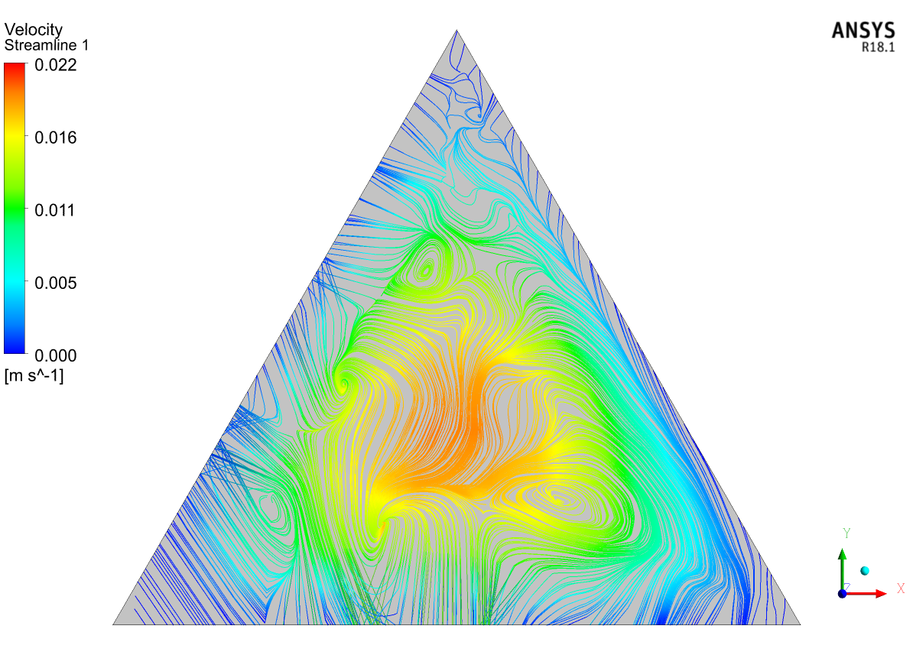
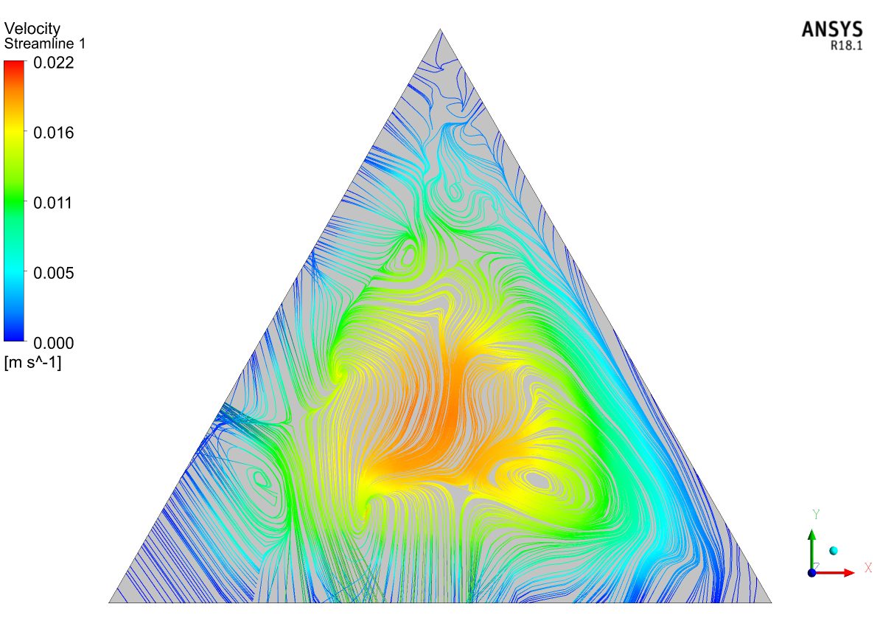
Velocity Streamlines contours at different locations for RI=0.1 and 0% volume concentration:
Fig-7: Velocity Streamline Contour at 100mm from inlet at 0% volume concentration and RI=0.1
Fig-8: Velocity Streamline Contour at Midpoint (1000mm from inlet) at 0% volume concentration and RI=0.1

Slide 21
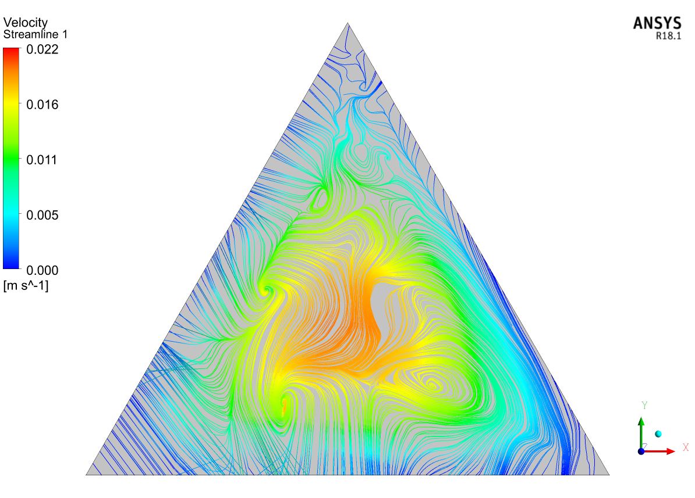
Fig-9: Velocity Streamline Contour near to outlet (1900mm from inlet) at 0% volume concentration and RI=0.1

Slide 22
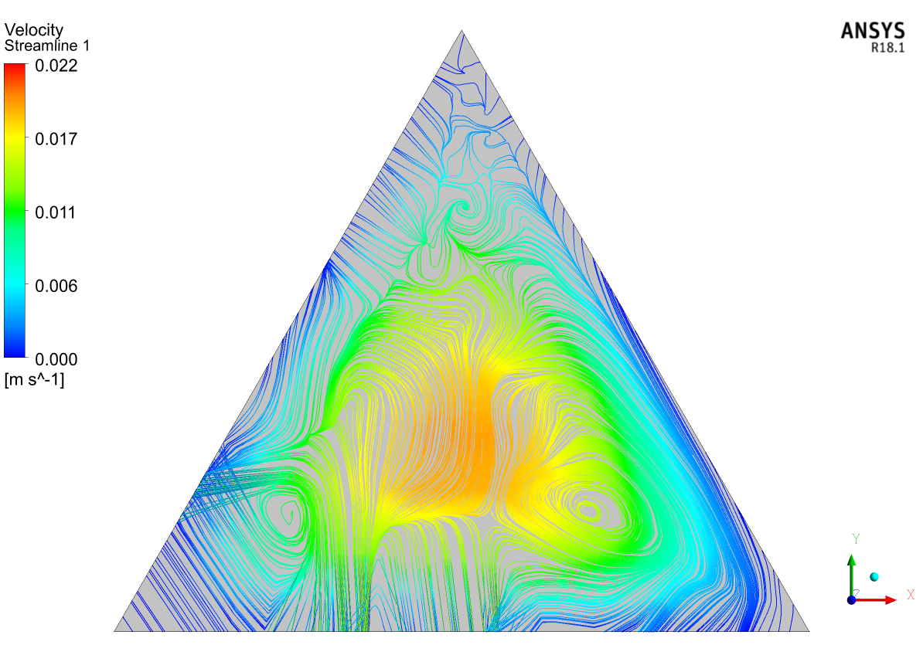
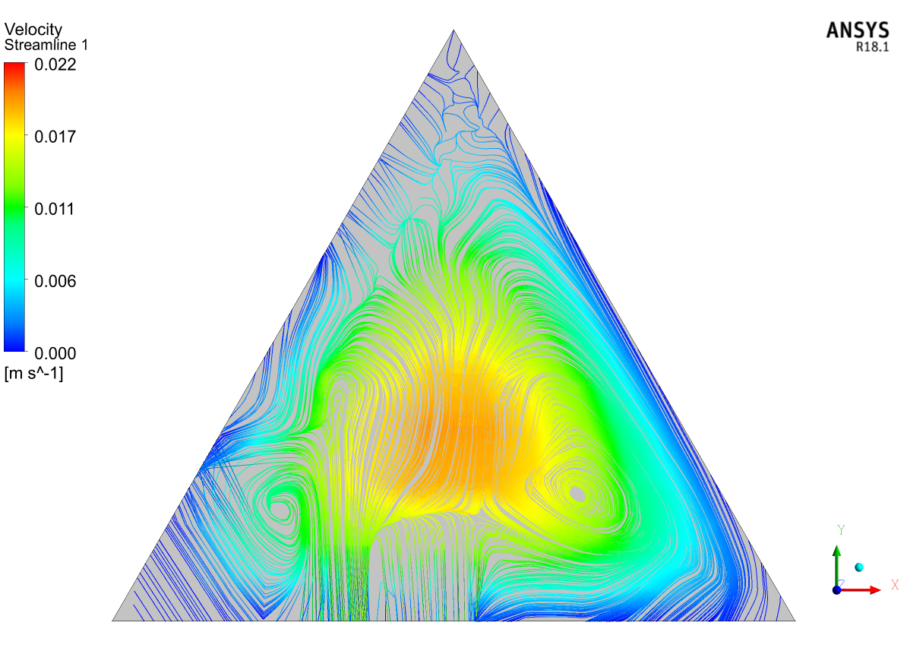
Velocity Streamlines contours at different locations for RI=0.5 and 0% volume concentration:

Slide 23
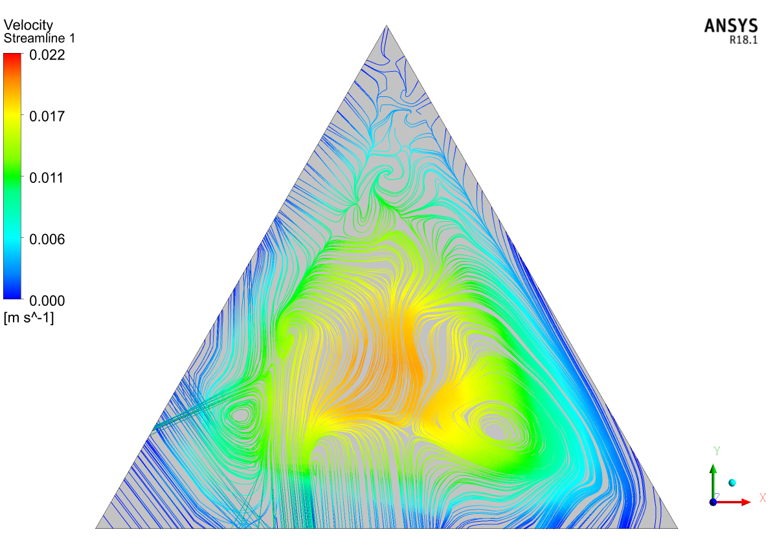

Slide 24
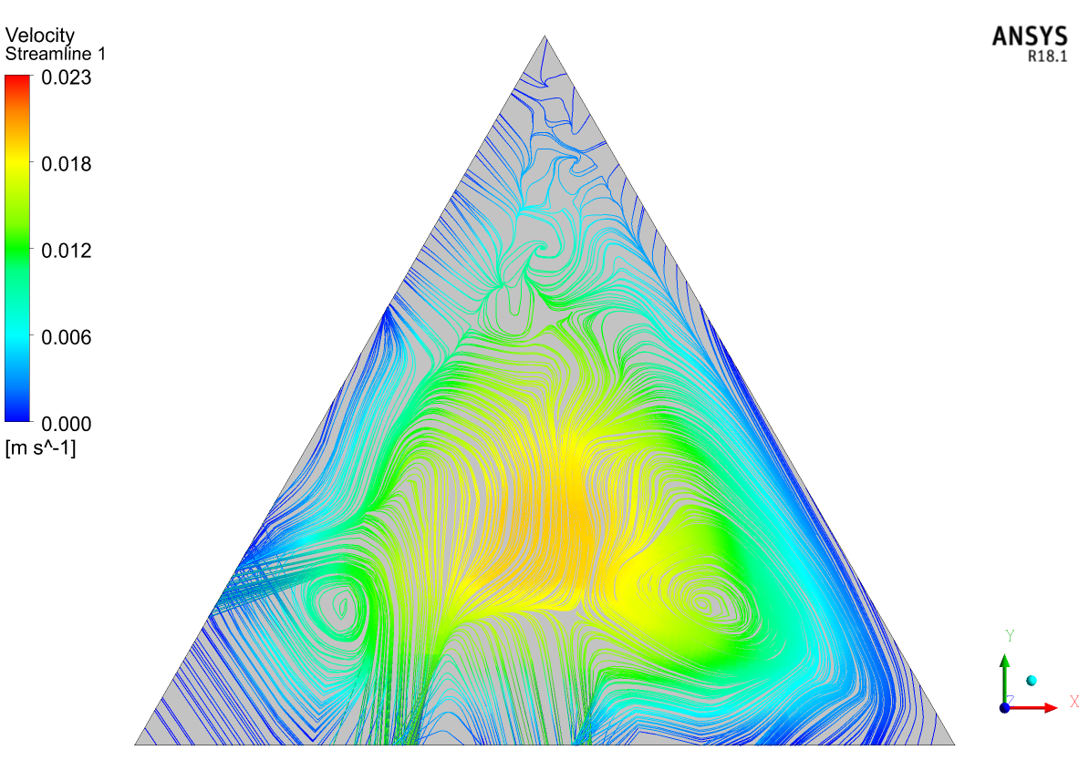
Stream line velocity contour at midpoint at RI=1, 0% volume concentration

Slide 25
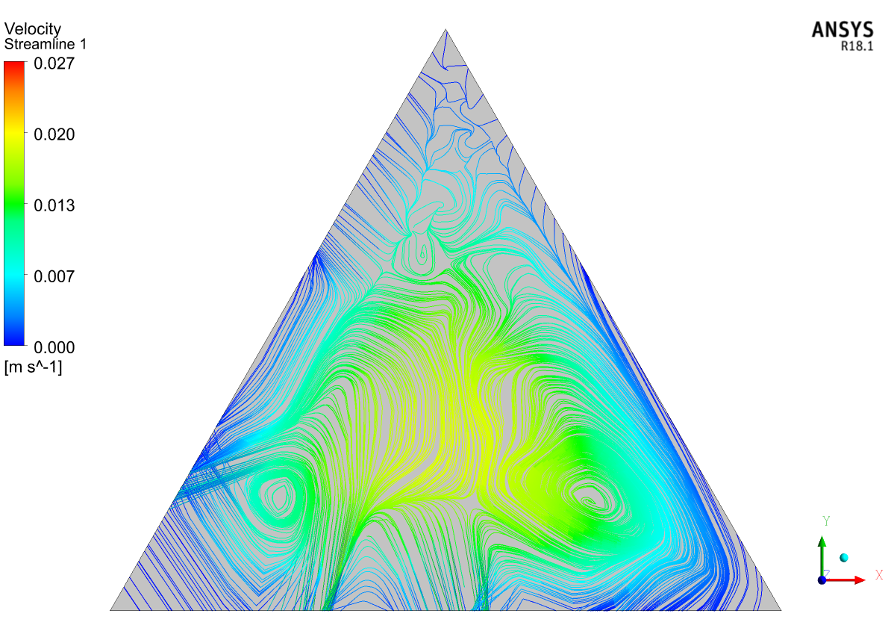
Stream line velocity contour at midpoint at RI=2, 0% volume concentration

Slide 27
THANK YOU

